Slide 1
The Roadmap to Net Zero:
How Amazon is Building the World’s
Most Sustainable Logistics Network
Director, Worldwide Ops Sustainability
Chris Atkins
Notes:
Hello everyone and thank you for joining. Today, it’s my honor to give you an overview of Amazon’s journey to become the world’s most sustainable logistics network and to talk about how could work together in the transition to electric vehicles. Amazon’s goal is to do this by 2040, ten hears ahead of the Paris Agreement (note, the MA goal is 2050).

Slide 2

“
I think our failure to fix climate change is a rhetorical failure of imagination. We haven’t convinced ourselves that it’s going to be great.
”
Saul Griffith
Notes:
To kick us off, I want to share a quote that I really love from Saul Griffith. Saul has a PhD in engineering from MIT, he’s a tech founder, an inventor, a best-selling author, and a McArthur genius grant award recipient. He’s also a renowned renewable energy advocate. On climate change he said, “I think our failure to fix climate change is a rhetorical failure of imagination. We haven’t convinced ourselves that it’s going to be great.” Our failure to fix climate change is a rhetorical failure of imagination. As an Amazonian who is proud of our ability to Think Big and Invent and Simplify, this quote always hits me like a punch in the gut. Whenever I think about this quote, I can’t help but think about the collective imagination and drive to invent and simplify that we have at Amazon and indeed here in this room. That’s what gets me excited about coming in to work each day.

Slide 3
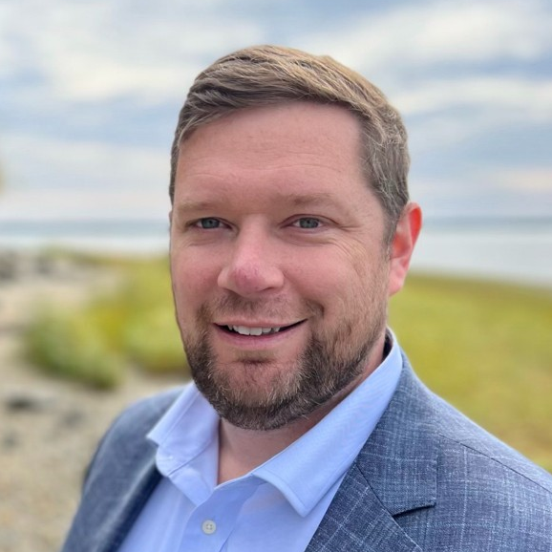
Chris Atkins
Director,
Worldwide Ops Sustainability
    13 years at amazon
NACF, GSF (Fresh), ATS, WWOS
Notes:
My name is Chris Atkins and I am the Director of Worldwide Operations Sustainability. A little about me, I’ve been an Amazonian for 13 years. I started out in customer fulfillment as an Area Manager working on the ship dock on nightshift in LEX1, making sure packages got to everyone's front door on time.
After many years in customer fulfillment, I had an opportunity to be a multi-site leader leading Fresh and Prime Now buildings in the Northeastern US.
In 2019, I moved to Amazon Transportation Services where I was one of the first members of the sustainability team for medium and heavy duty transportation. And for the last few years it’s been my honor to lead a global team of operations leaders who are collaborating with our businesses to make Amazon a leader in sustainability.

Slide 4
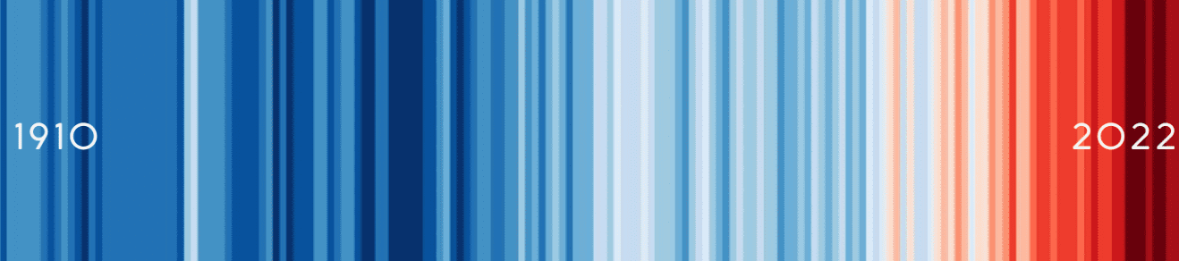
Baby Boomers
1948-62
Greatest
1913-27
Silent
1928-47
Gen X
1965-79
Millennials
1981-95
Gen Z
1998-2012
Gen Alpha
2013-22
Notes:
Why is sustainability important to operations? Our planet is at a tipping point. According to NASA, 2023 was the hottest year on record. The second and third hottest years on record both occurred in the last four years.
This image behind me shows the global temperature averages since 1910. As you can see, the last few decades have been ones of unprecedented warming. At Amazon, we follow the science and the science tells us that humanity has a limited window of time to act. To avoid the worst outcomes of climate change, our society needs to stop burning fossil fuels and emitting other harmful greenhouse gases into the atmosphere. We believe that success and scale bring broad responsibility and it is our responsibility to be a leader in combating climate change.

Slide 5
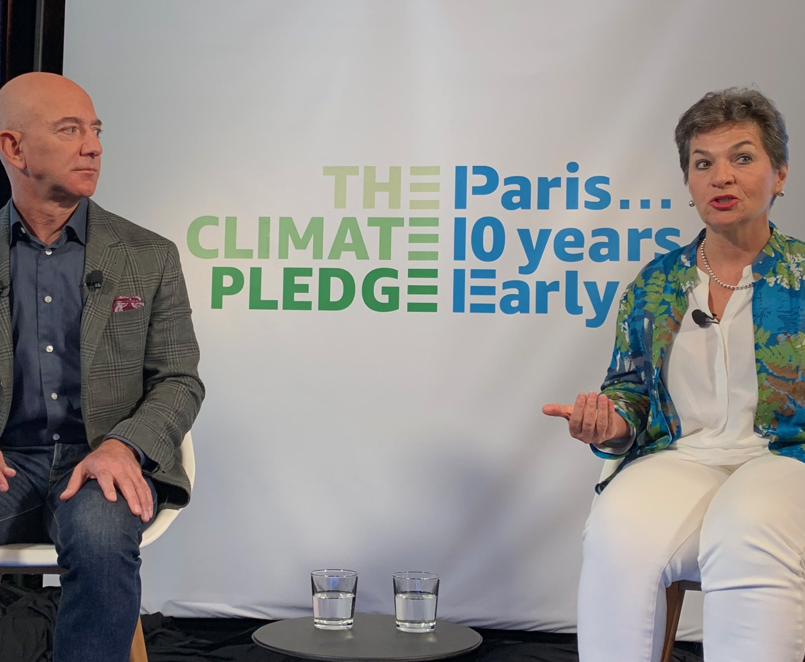
“Bold steps by big companies will make a huge difference in the development of new technologies and industries to support a low carbon economy.”
”
Christina Figueres
Notes:
That’s why Amazon co-founded the Climate Pledge in 2019, along with Global Optimism. The Climate Pledge is our commitment to reach net zero emissions by 2040, ten years ahead of the Paris Agreement.
As Christiana Figueres, one of the principal architects of the Paris Agreement stated, “bold steps by big companies will make a huge difference in the development of new technologies and industries to support a low carbon economy.”

Slide 6


NET ZERO BY 2040
530+
SIGNATORIES
Notes:
That’s why we’ve invited every company to join us by becoming a Climate Pledge signatory. To date, I’m happy to say that we have over 530 fellow signatories and counting

Slide 7
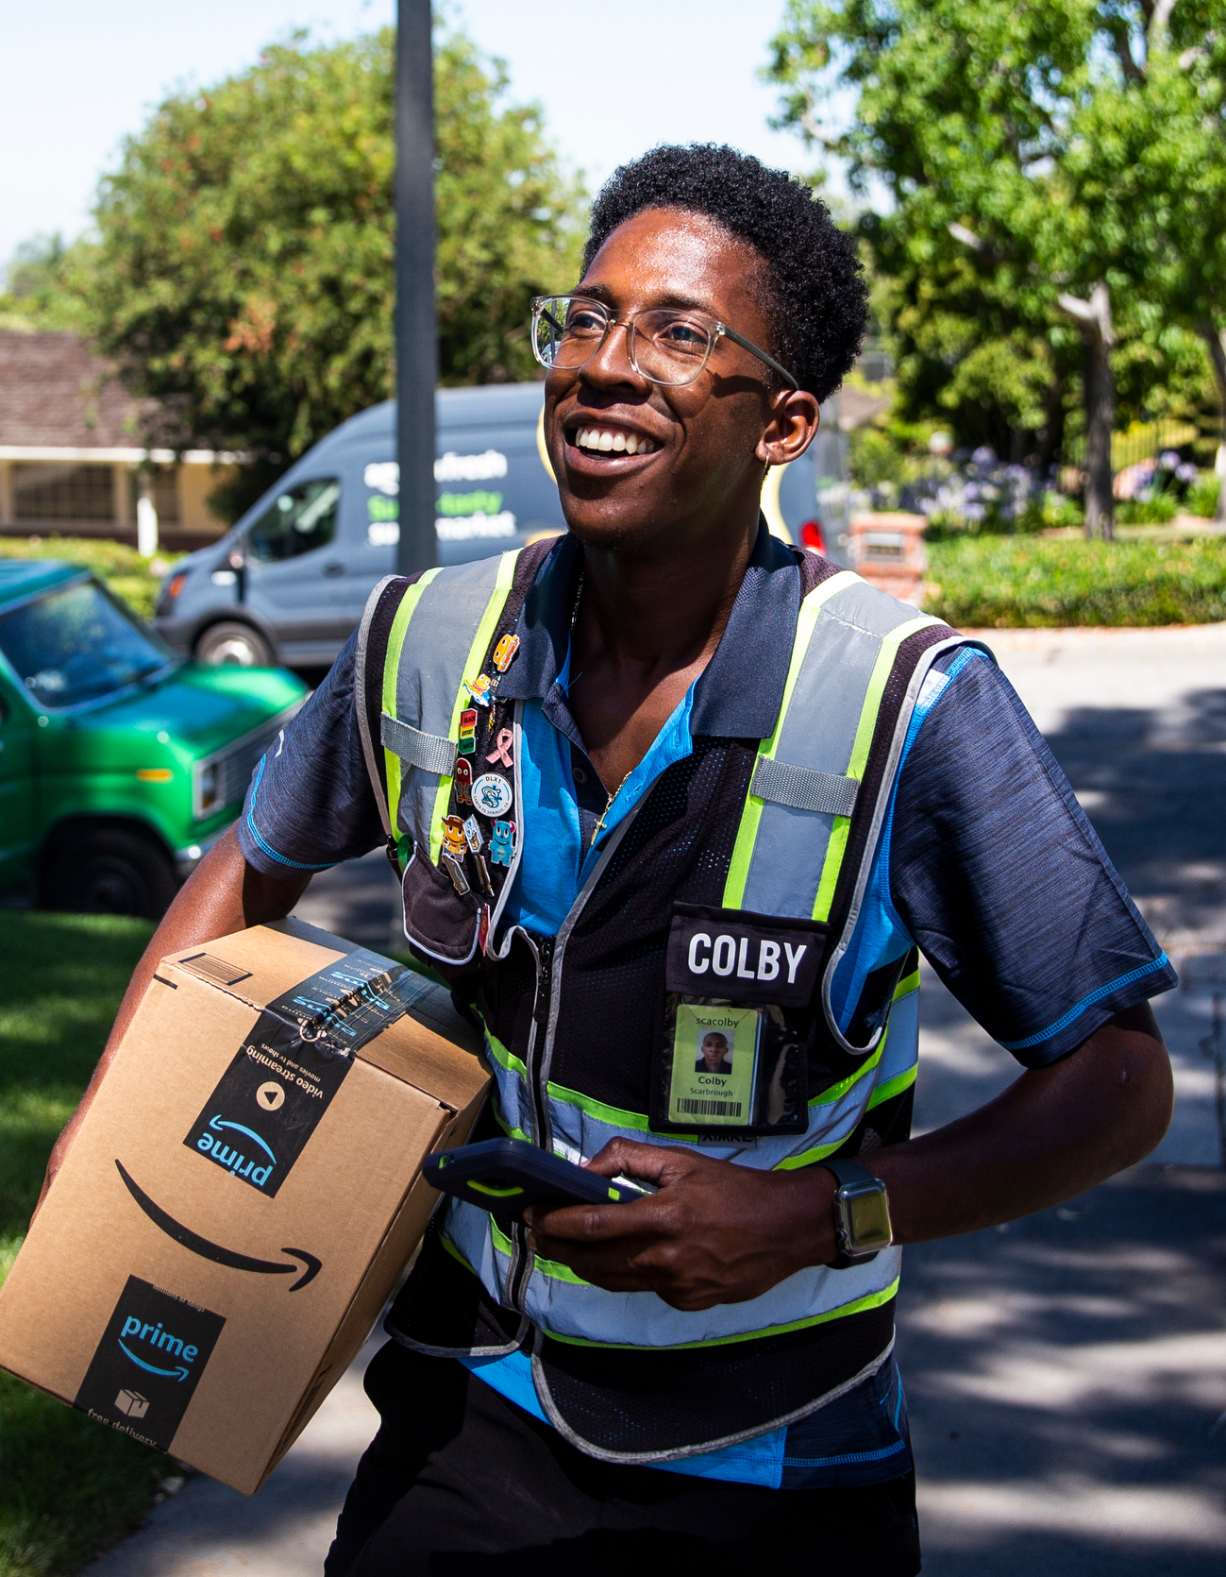
Roadmap to Net Zero
Successes and Challenges
Notes:
Let’s turn to Amazon’s success so far, and some of the specific challenges to the EV transition that a little imagination can surely solve

Slide 8
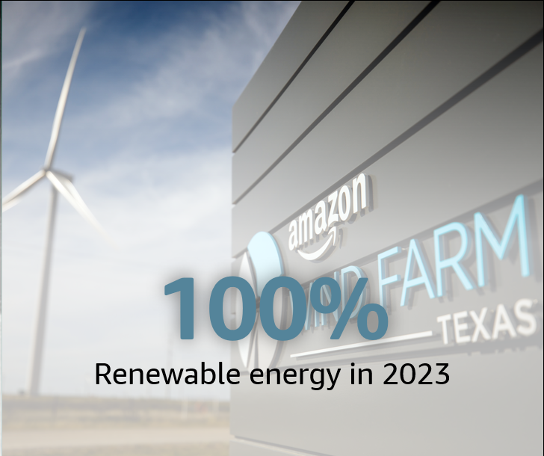
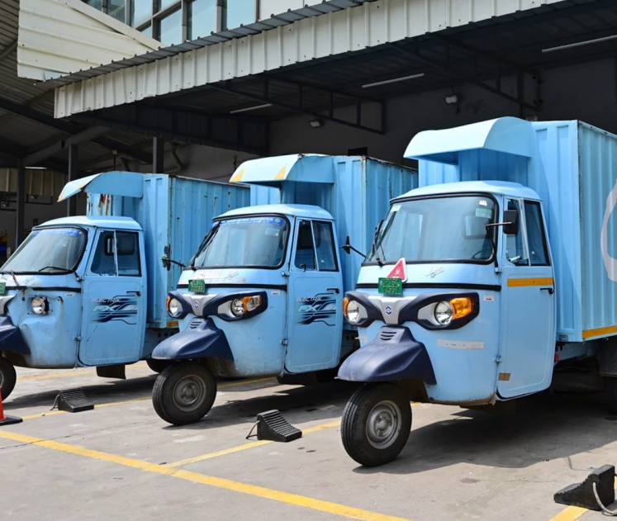
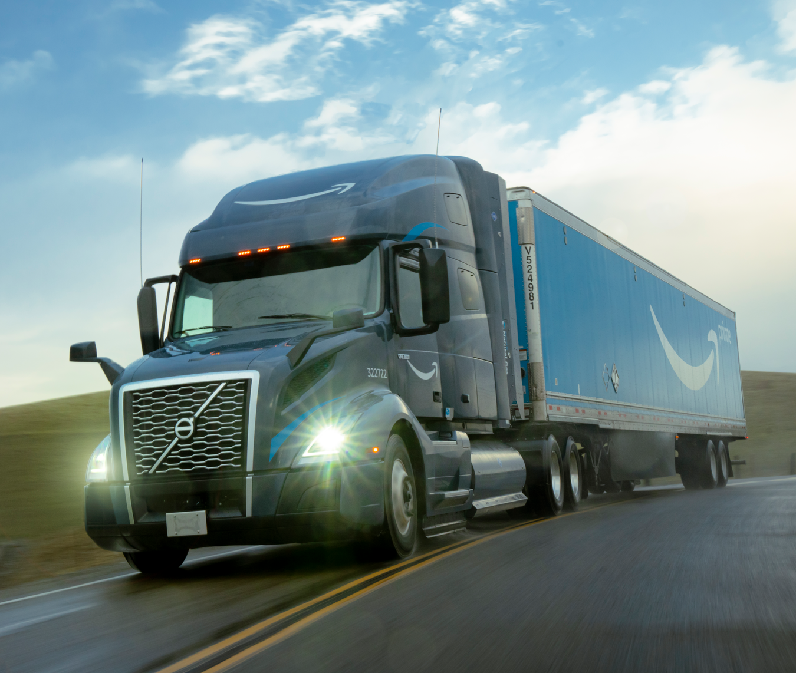
Successes To Date
3,000+
CNG Trucks
~10,000
3 Wheel Electric Delivery Vehicles
~180
Electric Trucks & Electric Yard Hostlers
Notes:
In 2023, we were the world’s largest purchaser of renewable energy for the fourth year in a row and we achieved out 100% renewable energy goal two years early. All of the electricity consumed by Amazon’s operations is matched with 100% renewable energy.
In middle mile, we’ve converted the majority of our tractor-trailer fleet from diesel to renewable natural gas as an interim step towards net-zero carbon emissions. We’ve deployed over 3,000 Compressed Natural Gas trucks, with 90% of them powered by renewable natural gas, served by 19 CNG/RNG fueling stations across North America. We don’t have any CNG sites in Boston at this time, but we have 1 site in Baltimore, MD and two sites in New Jersey.
We’ve also deployed the ~80 battery electric day cabs and ~100 electric yard hostlers that we’re learning from as we prepare to scale these vehicles into our network in the future. We’re determined to electrify medium- and heavy-duty trucking.

Slide 9
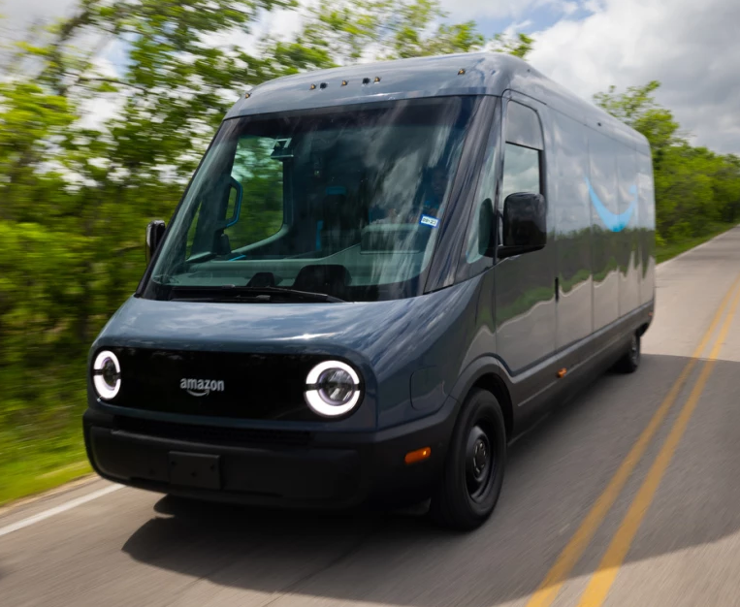
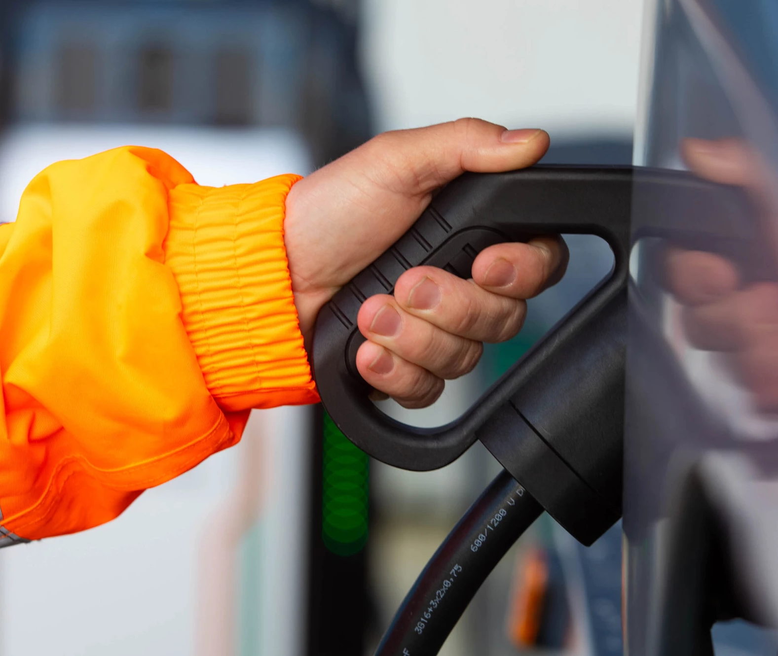
Successes To Date
>15,000
Rivian Electric Vans
>17,000
Chargers Deployed
Notes:
We now have over 15,000 Rivian electric delivery vans on the road in last mile in the United States, on our way to 100k by 2030. In the Boston region, we currently have around 340 electric vans dispatched from 5 different Last Mile Delivery stations.
We have over 17,000 chargers deployed, making us the world’s largest private charging network. We’ve set an ambitious goal of launch 2,000-3,0000 Level 2 van chargers in Boston between now and 2025.
Our customers love seeing the Rivian vans in their neighborhoods and the vehicles get high praise from our drivers for their safety features, spacious cargo area, and ease of operation.
I’ll also mention that we work closely with MIT on sustainability and also have a partnership with Greentown Labs we’re very proud of. We just toured Greentown Labs a few weeks ago.

Slide 10
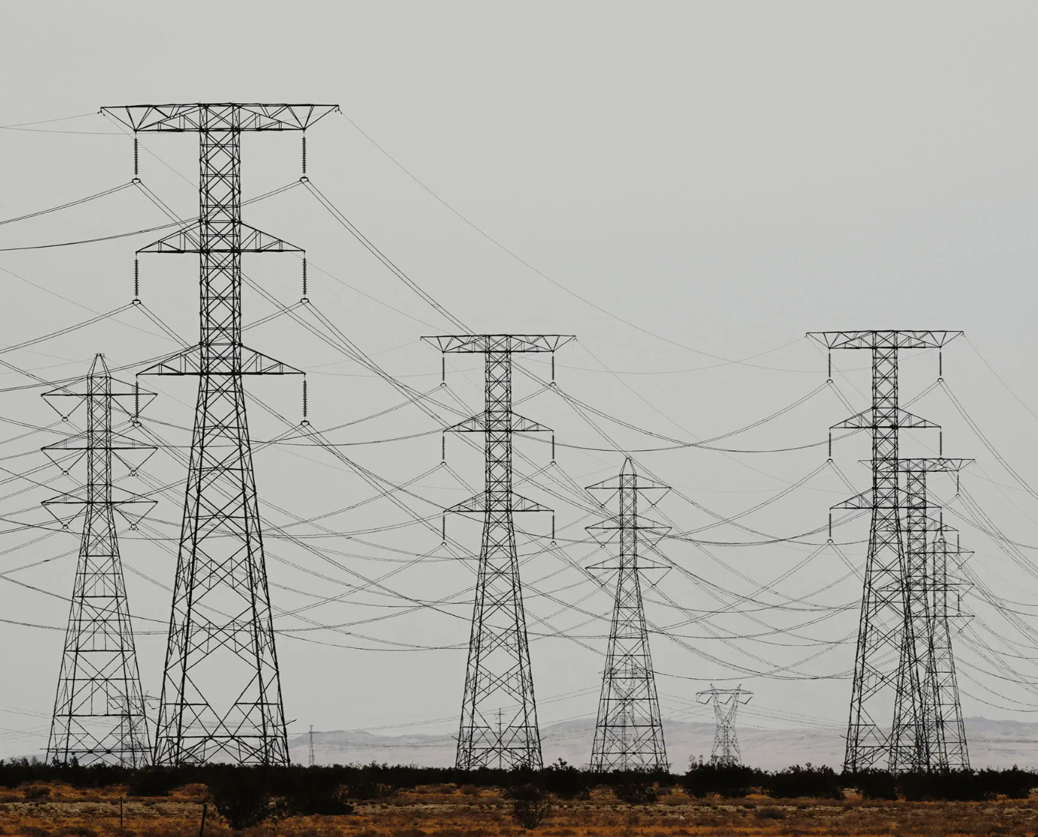
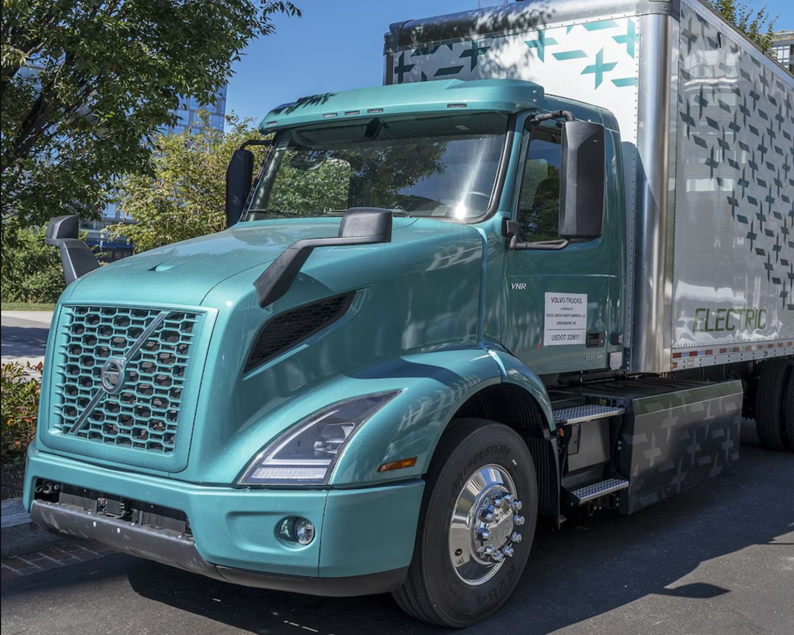
challenges
Securing Power
Getting Trucks
Notes:
So what are the key challenges ahead for Amazon?
First big one is securing power.
Typically, or biggest blocker for EV expansion in the US is securing sufficient grid power.
It takes approximately 1 megawatt of grid capacity for every 100 L2 chargers we install for delivery vans.
For bigger electric trucks, like day cabs and sleeper cabs, it can take multiple megawatts, and up to three years to get power to sites.
There are hundreds of electric utilities across the country. Each one has to figure out how to update their processes so that they can provide the power needed to decarbonize transportation.
We work with the Edison Electric Institute and the Electric Power Research Institute on a project called EVs2Scale2030 that is helping utilities and their oversight bodies so that we can deploy electric vehicles faster while minimizing grid impacts.
I’m interested in discussing today how we can address this challenge together.
The second challenge is that we can’t get bigger electric trucks at the right price yet. Day cabs and sleeper cabs run long routes with heavy loads and are a big source of carbon emission. But right now, electric day cabs are essentially hand made—there isn’t series production yet—and you can’t even buy a electric sleeper cab.
We’re working with NGOs and governments on sending the demand signals to automakers, and have joined a coalition led by automakers called PACT to build more truck charging infrastructure. We think this will help solve the “chicken and egg” situation with electric trucks and charging infrastructure.
This is another area where I think we can work together.

Slide 11
How can we Think Big and Invent and Simplify, to solve these challenges together?
Looking forward to the discussion.
Notes:
Thank you and handoff to next speaker

